Slide 1

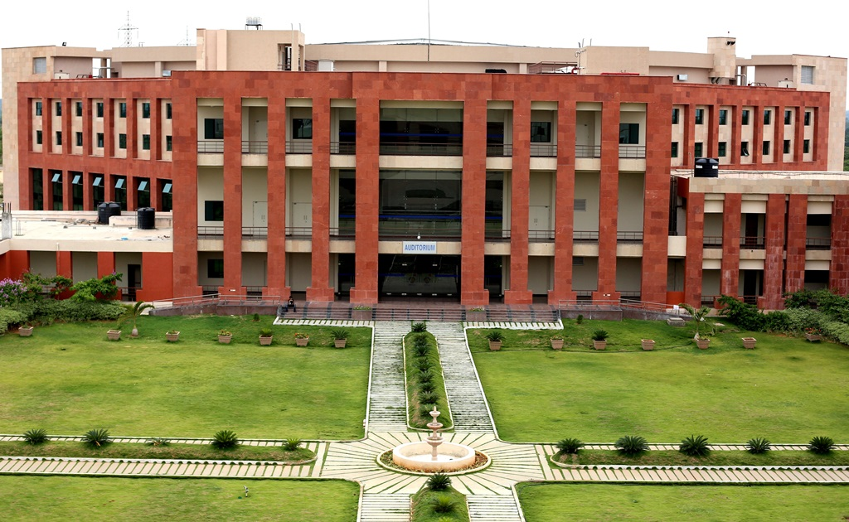
Principles of Programming Languages
(CS F301)
Jabez Christopher
Assistant Professor
Department of CSIS

Slide 2
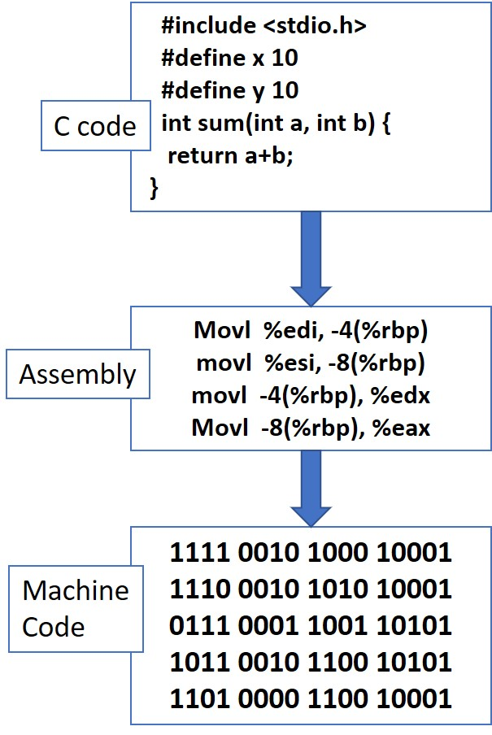
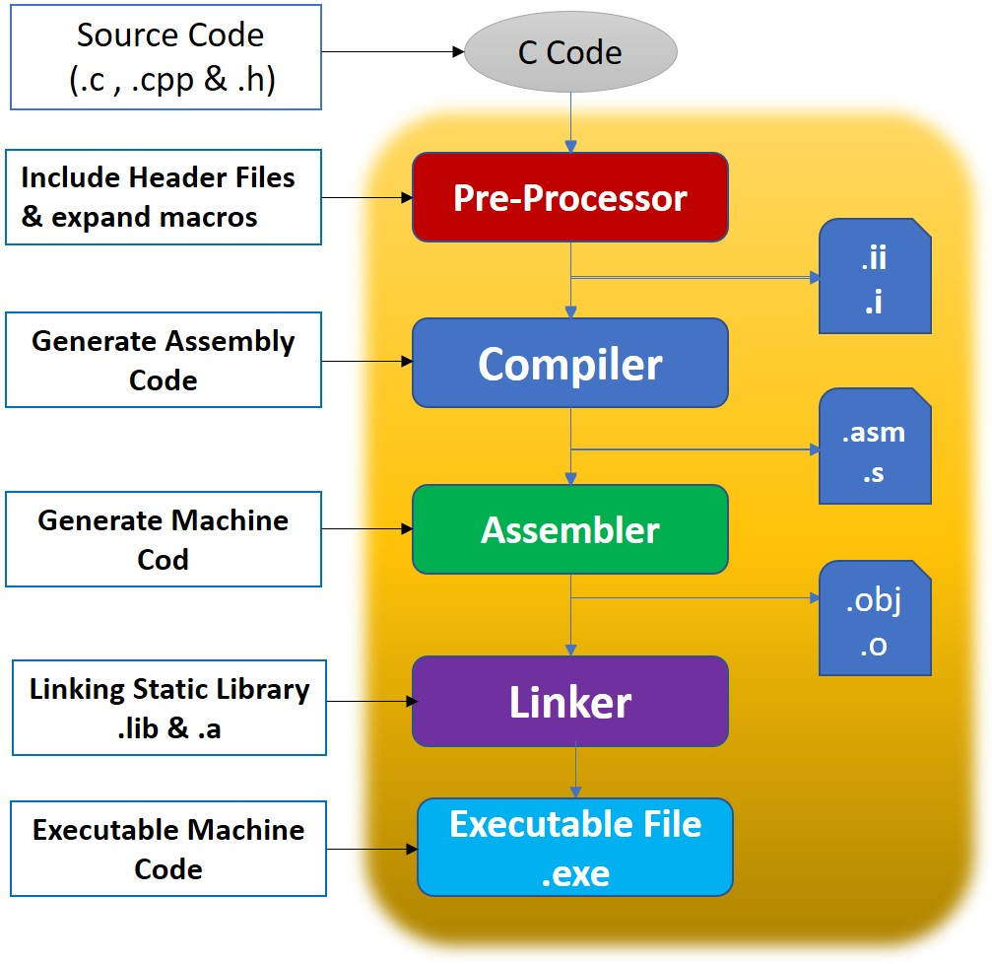
Language Implementation Methods

Slide 3
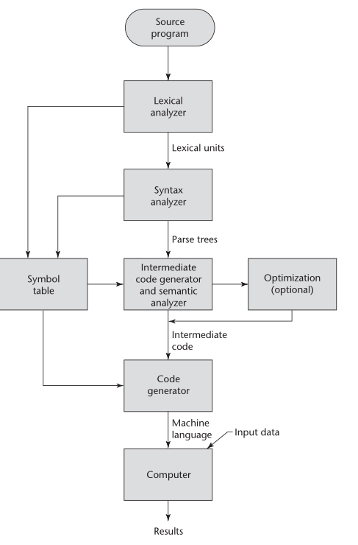
COMPILATION
Source language
Lexical analyzer
Syntax analyzer
Intermediate Code Generator
Code Optimizer
Code Generator

Slide 4
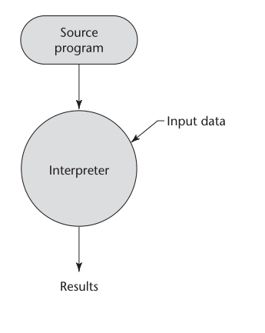
Interpreter: Pure Interpretation
The interpreter program acts as a software simulation of a machine whose fetch-execute cycle deals with high level language program statements rather than machine instructions
Advantage: debugging is easy. Good for development
Disadvantage: slow execution.
It must be decoded every time

Slide 5
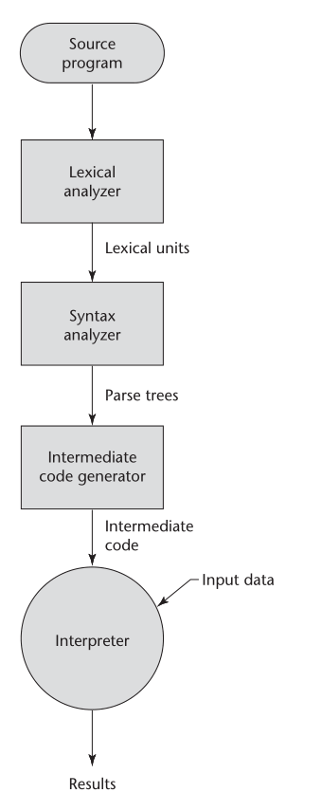

Hybrid implementation system
Translate high-level language programs to and intermediate language designed to allow easy interpretation.
https://www.youtube.com/watch?v=FQfVPFr7HYo

